Slide 1
Financial Modeling
Balance Sheets, Income Statements, Cash Flow Statements
Jacqueline Garner, Ph.D.
Lecturer
Scheller College of Business
Building Cash Flow from Assets

Slide 2
Before We Begin…
Notes:
In this lesson we will discuss Financial Cash Flow. It is a bit different than Accounting Cash flow as we separate investing decisions from financing decisions.

Slide 3
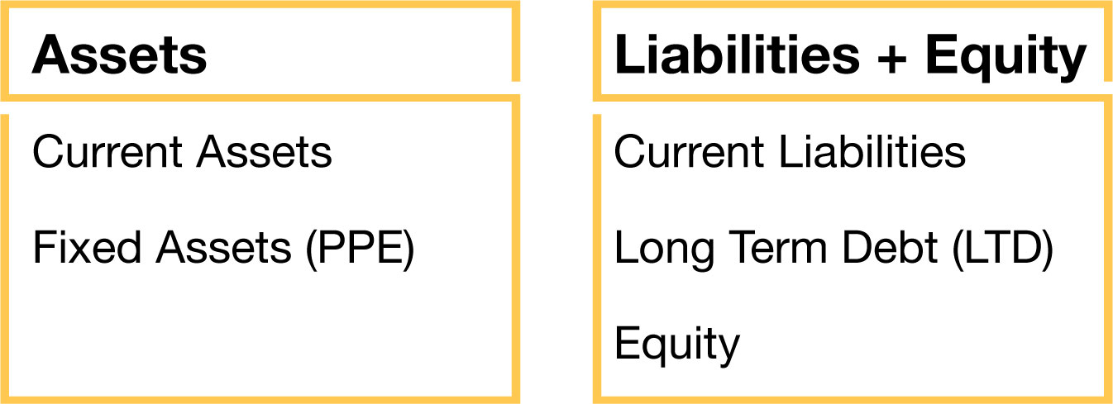
Cash flows FROM assets and TO Claimants
Investing Decision
Financing Decision
Notes:
In finance, we view the balance sheet as assets and the claims against those assets. So the assets produce cash flows (CFS FROM assets) and since the debt and equity are claims against the assets, the CFs produced by the assets go TO the debtholders (aka bondholders) and the equityholders (aka stockholders)

Slide 4
Financial Cash Flows
Financial Cash Flows
Cash flow FROM Assets
Cash flow TO debtholders
Cash flow TO equityholders

Slide 5
Organization of Cash Flow from Assets
EBIT
Plus Depreciation/amortization
Less Taxes
Operating cash flow
Less change in net working capital (NWC)
Less investment in fixed assets (capital expenditures)
= CF FROM ASSETS
Notes:
Let’s first tackle CF from assets. It is define as shown here. One thing to note: we begin with EBIT, not NI. Why? Notice we do not deduct interest. It’s because assets do not produce interest. Interest, which we will see later, is something the bondholders receive, not something assets produce.

Slide 6
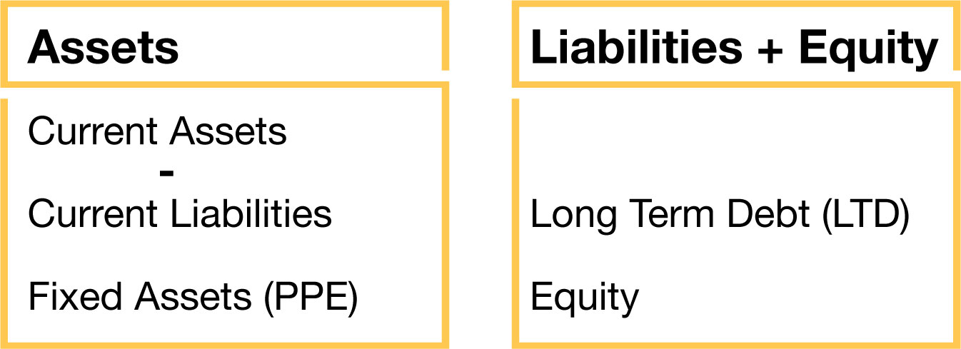
CF from Assets
NWC is effectively netting the CL against the CA
Fixed assets produce the OCF
Capital expenditures is the investment (or sale) of more fixed assets
Notes:
A picture may help explain this. This is similar to the balance sheet a few slides before but we have moved CL over to the asset side. Let’s go through each piece of the definition: OCF. Well, fixed assets, the PPE is what produces the OCF.
Then we subtract change in NWC. What is NWC = CA – CL so in this picture we see we are netting CL against the CA. Effectively this is similar to the operating section of an acctg CF statement whereby we are taking care of accrual accounting. Finally roman III was investment in fixed assets/cap ex.

Slide 7
Example of CF from Assets
Let’s look at an example:
Please download the file named
“Balance_Sheets_Income_Statements_Example.xlsx”

Slide 8
Summary
Notes:
This lesson was an explanation and demonstration of CF from assets. Thank you!

